Slide 1

Football Data Analysis Capstone Project
Student Name :RAJASHER THOTA
Mentor Name:JAYA PANDEY MAM

Slide 2

Introduction
Football is more than just a game; it is a global phenomenon that generates passion, loyalty, and significant economic impact. With vast amounts of data generated from each match — including player performance, team strategies, stadium attendance, referee decisions, and market valuations — data analytics has become a vital tool for uncovering patterns and gaining insights in the football ecosystem.
This capstone project, titled "Football Data Analysis", aims to leverage real-world football datasets to perform comprehensive data exploration, statistical analysis, and predictive modeling. The datasets contain detailed information about players, matches, events, appearances, and lineups from various competitions.

Slide 3

Project Breakup
1
2
3
4
5
6
7
8
9
10
Phase 1: Data Preprocessing – Load, clean, and merge five datasets using common keys like game_id and player_id.
Phase 2: Player Performance Analysis – Analyze player stats like appearances, goals, assists, age, and position.
Phase 3: Team Performance Analysis – Evaluate team wins, goals, and match outcomes.
Phase 4: Player Market Value – Study the relationship between player performance and market value.
Phase 5–6: Statistical Tests – Use t-tests to compare performance between teams and players.
Phase 7: Attendance Analysis – Examine stadium attendance trends and factors affecting crowd size.
Phase 8: Substitution & Referee Review – Analyze substitution patterns and referee decisions.
Phase 9: Match Outcome Prediction – Use ML models to classify match outcomes (win/loss/draw).
Phase 10: Player Value Prediction – Build regression models to estimate player market value.
Phase 11–12: Insights & Business Conclusion – Summarize key findings and provide strategic recommendations.

Slide 4

Focus Areas
Player Performance Metrics
Goals, assists, yellow/red cards, substitutions, and appearances.
Team-wise Match Analysis
Wins, losses, draws, goals scored/conceded across games.
Player Market Valuation
Impact of performance, age, position, and experience on market value.
Statistical Comparisons
Use of hypothesis testing to compare players and teams.
Audience and Attendance Analysis
Patterns and influencing factors in stadium attendance.
Referee and Substitution Patterns
Substitution timing, player impact, and referee decision trends.
Predictive Analytics
Machine Learning models for match outcome classification and player value prediction.

Slide 5
Tools and Techniques
Python & Machine Learning:
Used for data cleaning, transformation, statistical analysis, and building
regression & classification models.
Excel:
Used for initial exploration, pivot tables, and descriptive statistics.
MySQL:
Employed to query structured data for extracting meaningful subsets and joining
multiple tables.
Tableau:
Used to build interactive dashboards for visualizing player performance,
club-wise contributions, and KPIs.

Slide 6
Project Objective
The objective of this project is to analyze football player and match data to uncover key performance insights.
It aims to identify top scorers, efficient players, and performance trends using statistical and machine learning techniques.
The project involves data cleaning, integration, univariate and bivariate analysis, and building predictive models.
Clustering and classification methods are applied to group and categorize players.
Tableau dashboards are used to visually communicate insights for decision-making.
Ultimately, this analysis supports data-driven evaluations of player contributions and team strategies.

Slide 7
Phase 1 and phase2: Data Cleaning
Objective: Remove inconsistencies, handle missing values.
Common Steps: Null handling, type conversion, renaming.
Importance: Ensures data integrity and accurate analysis.
Goal: Prepare clean and usable datasets.

Slide 8
Phase 3: Feature Engineering
Phase 4: Exploratory Data Analysis
Objective: Create new features that better expose the underlying data patterns.
Techniques: Binning, encoding, transformations.
Benefits: Improved model performance and interpretability.
Goal: Enhance the dataset with meaningful variables.
Objective: Understand the data structure and patterns.
Methods: Statistical summaries, data visualization.
Tools: matplotlib, seaborn, pandas profiling.
Goal: Generate insights and hypotheses.

Slide 9
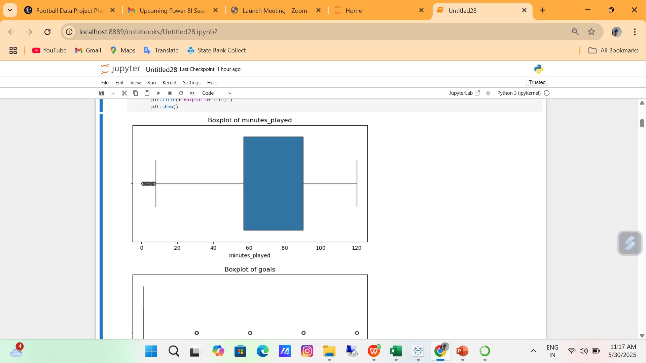
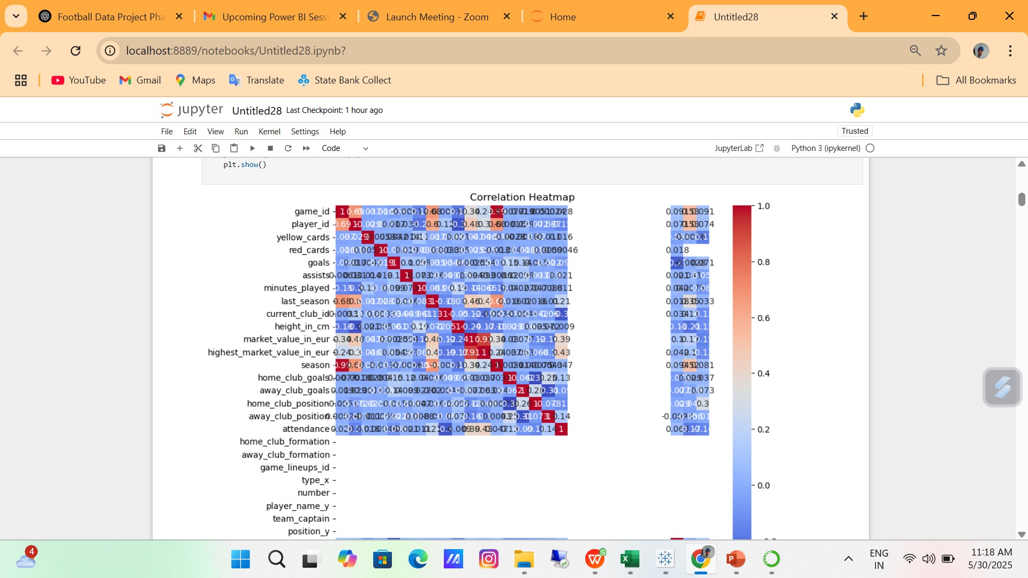
Boxplot to detect outliers for numeric columns andAutomatically select numeric columns available in df

Slide 10
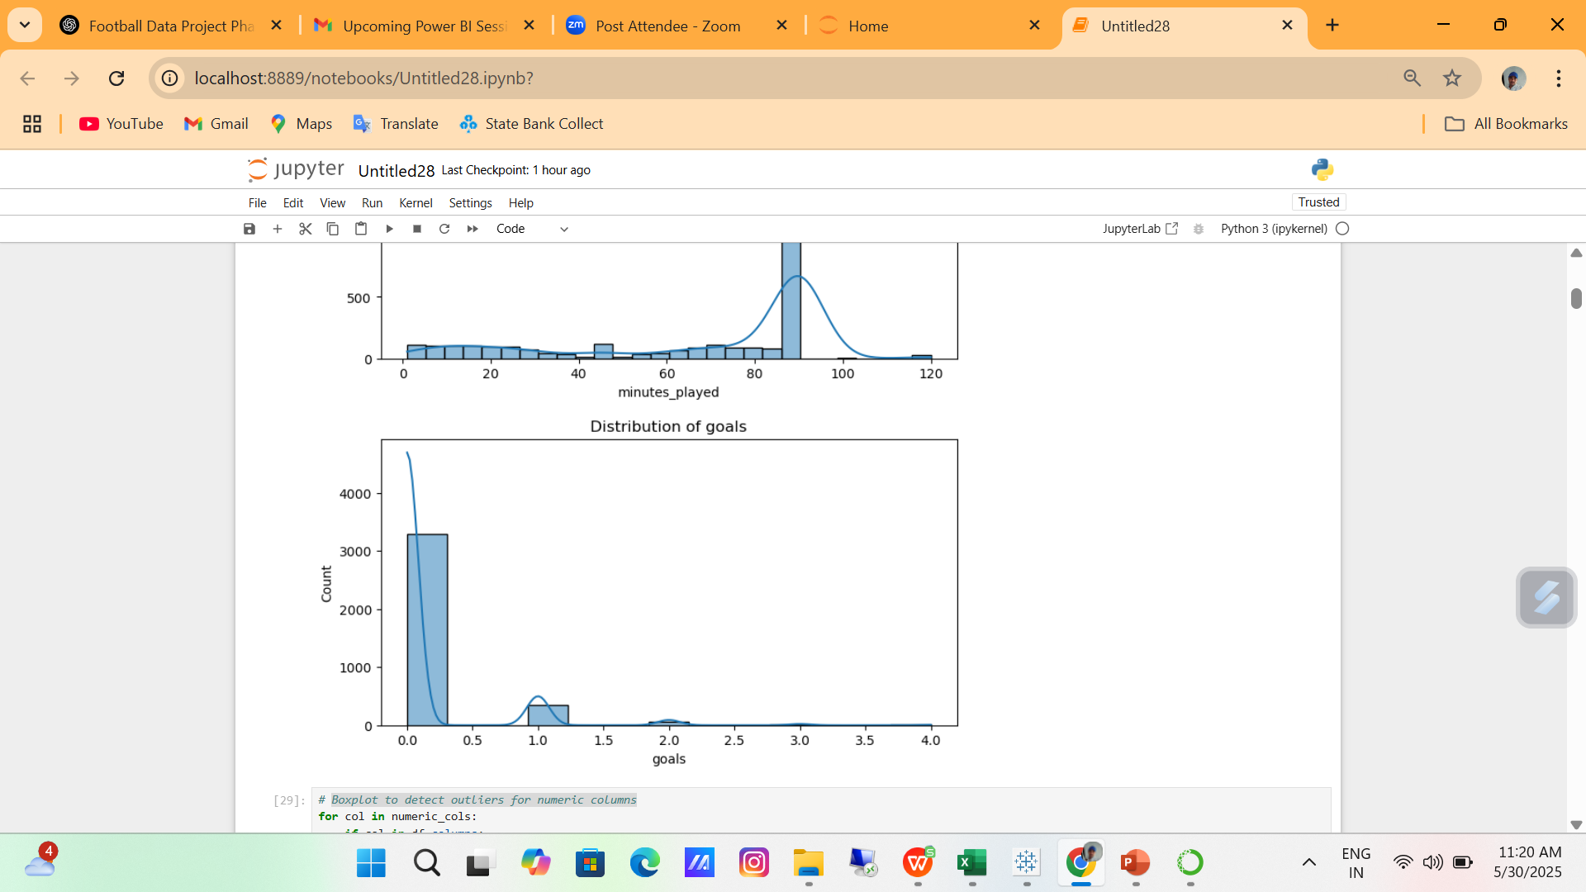
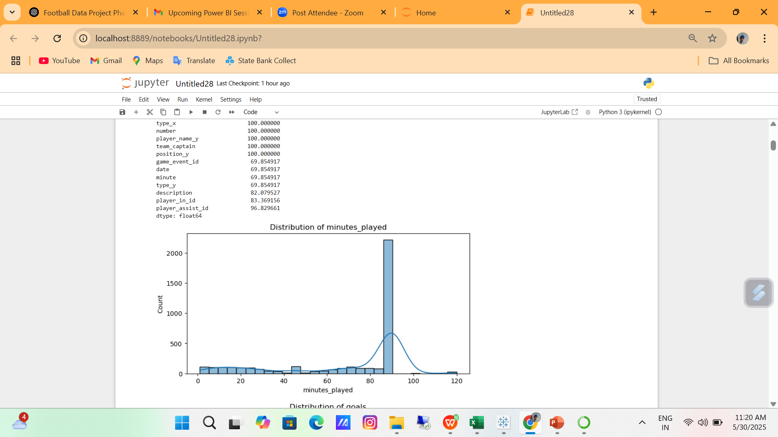
# Visualize distribution of some numeric columns (replace with relevant columns)

Slide 11
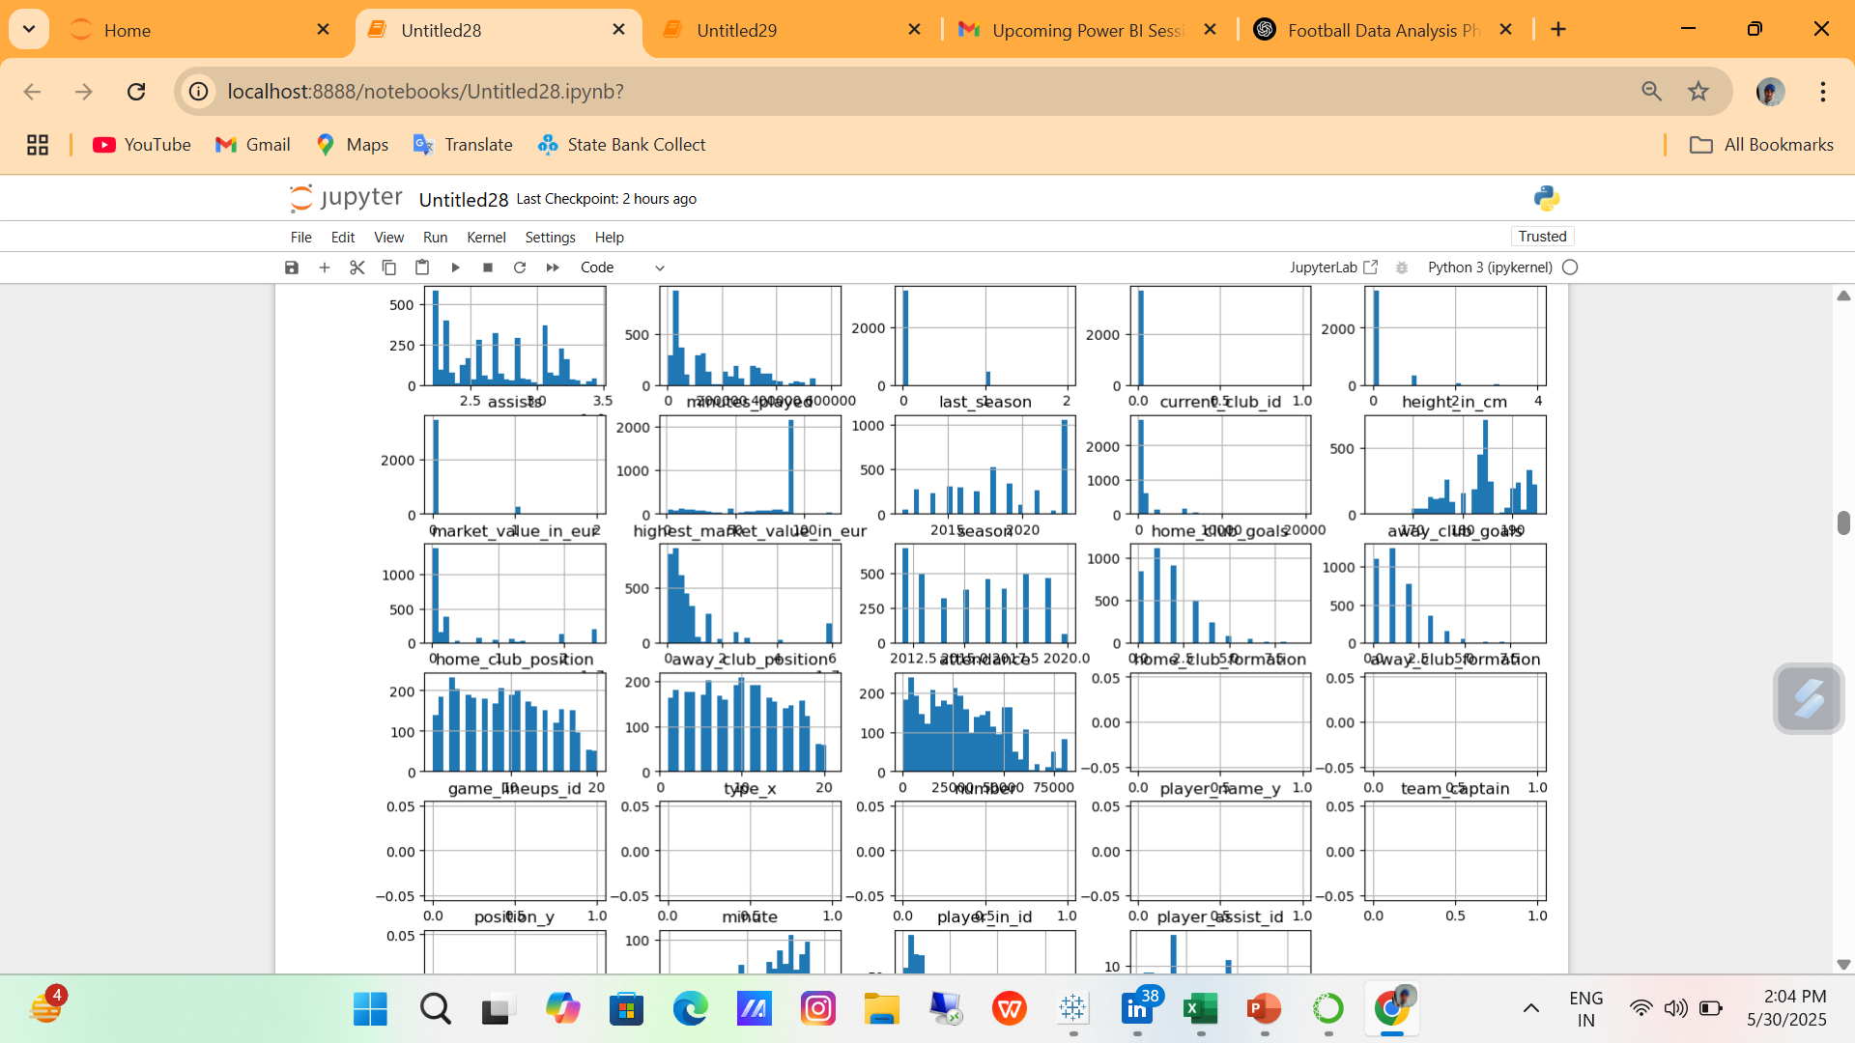
# Plot distributions for numeric variables

Slide 12
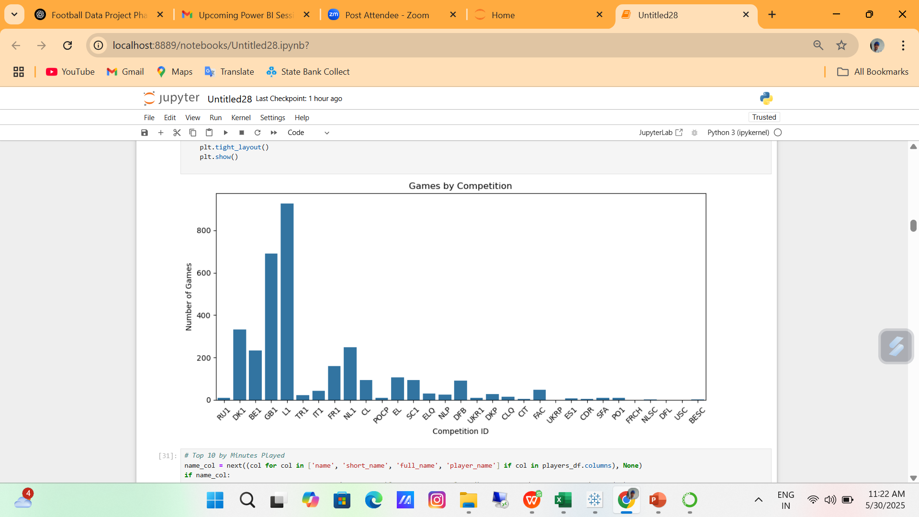
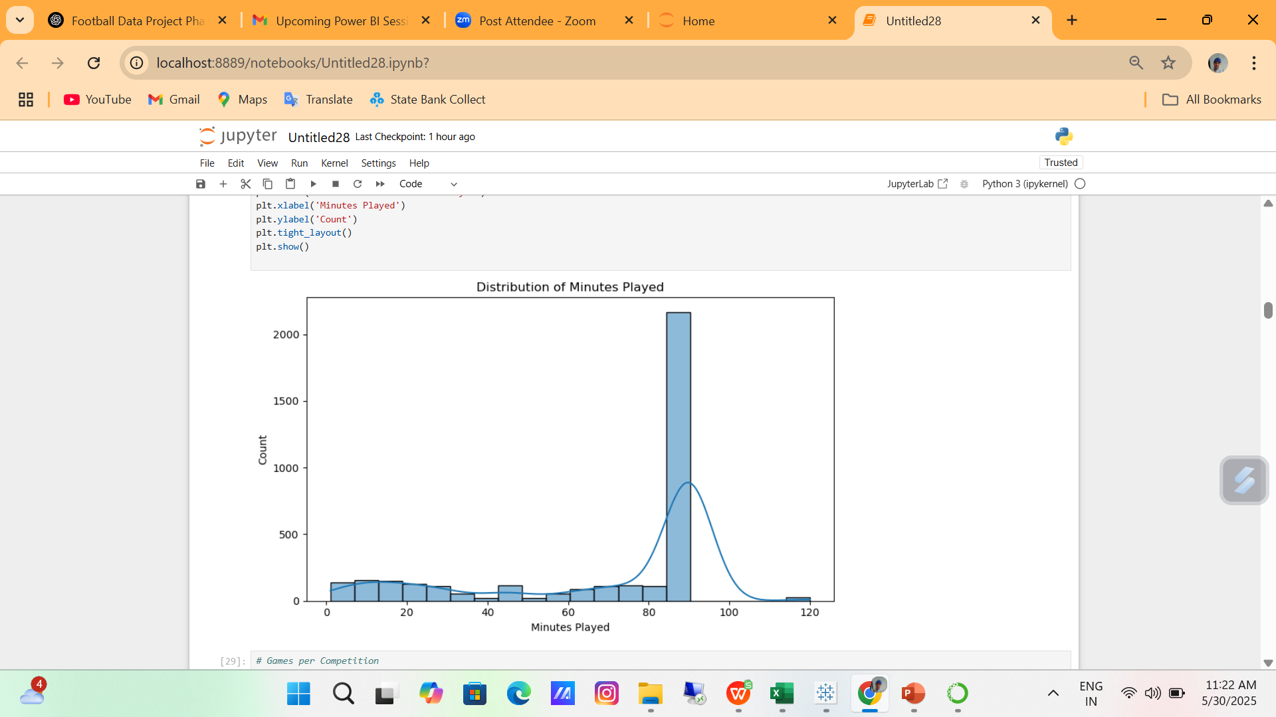
# Minutes Played Distributionand # Games per Competition

Slide 13
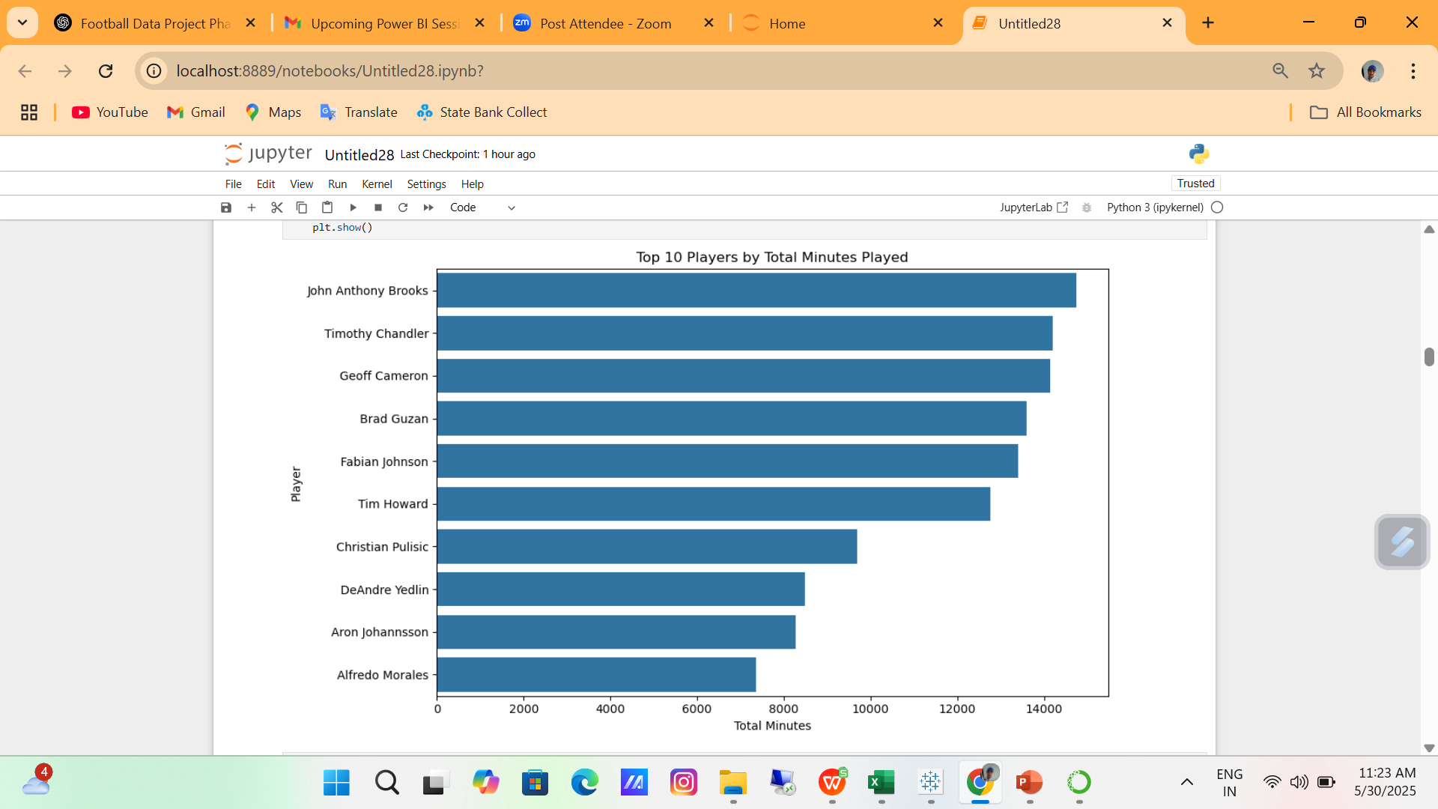
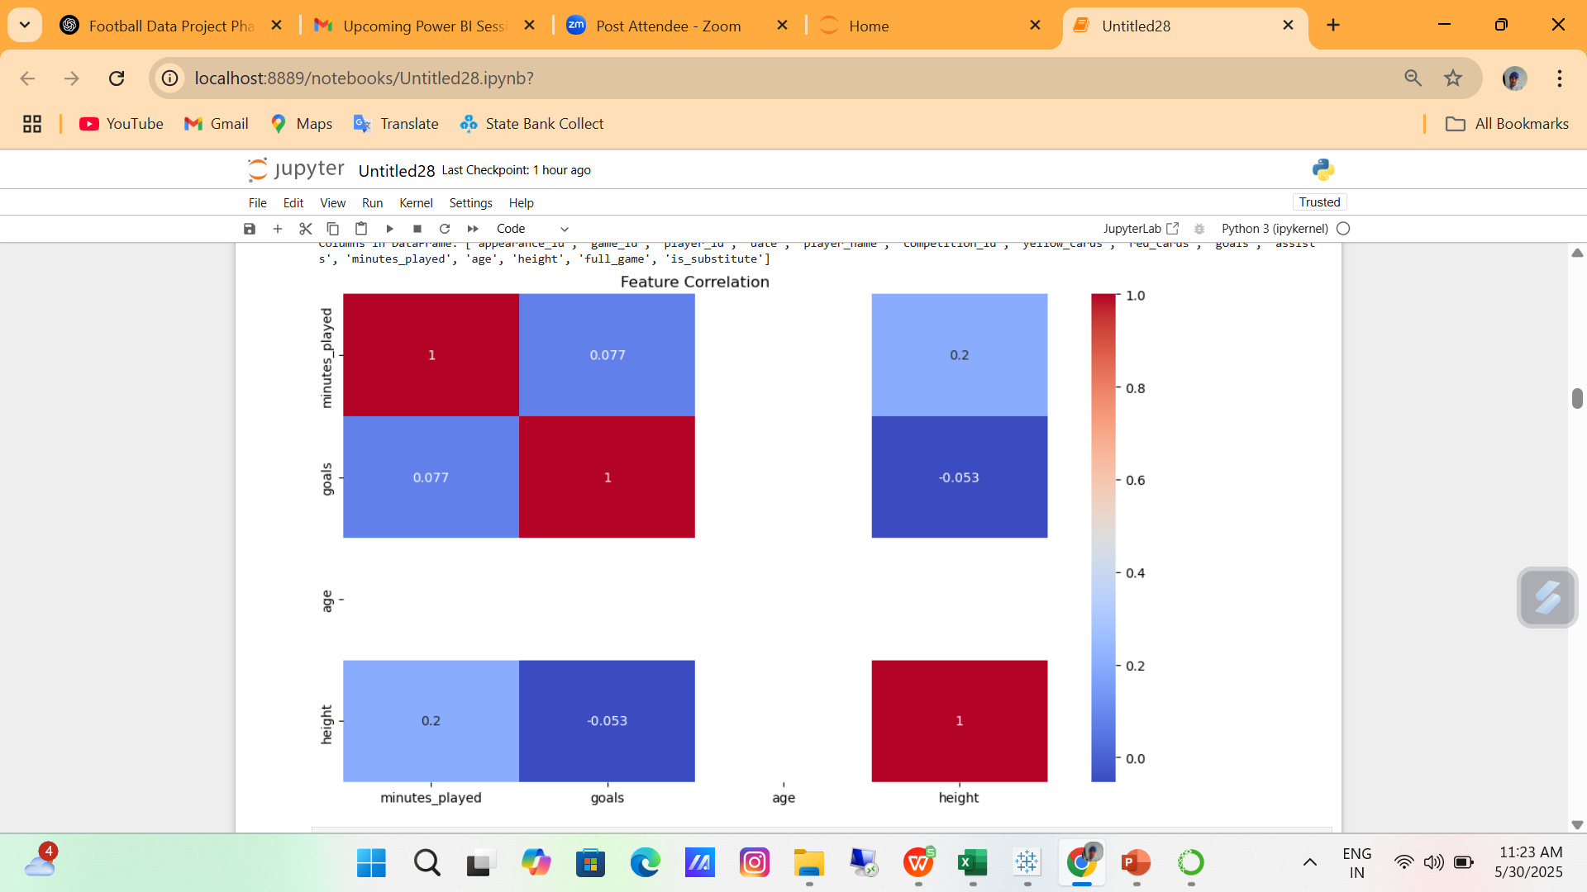
# Top 10 by Minutes Played
# Columns you want to include in heatmap

Slide 14
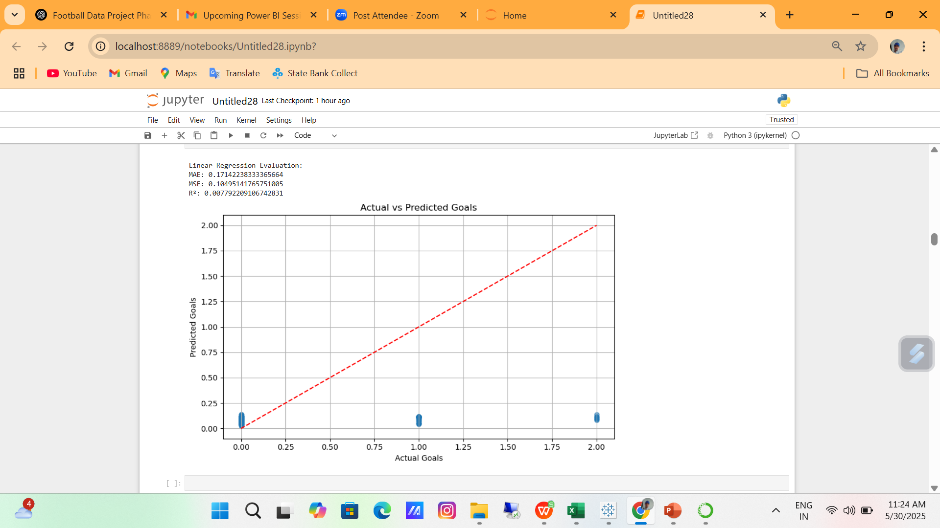
Machine Learning – Linear Regression (Predict Goals)

Slide 15
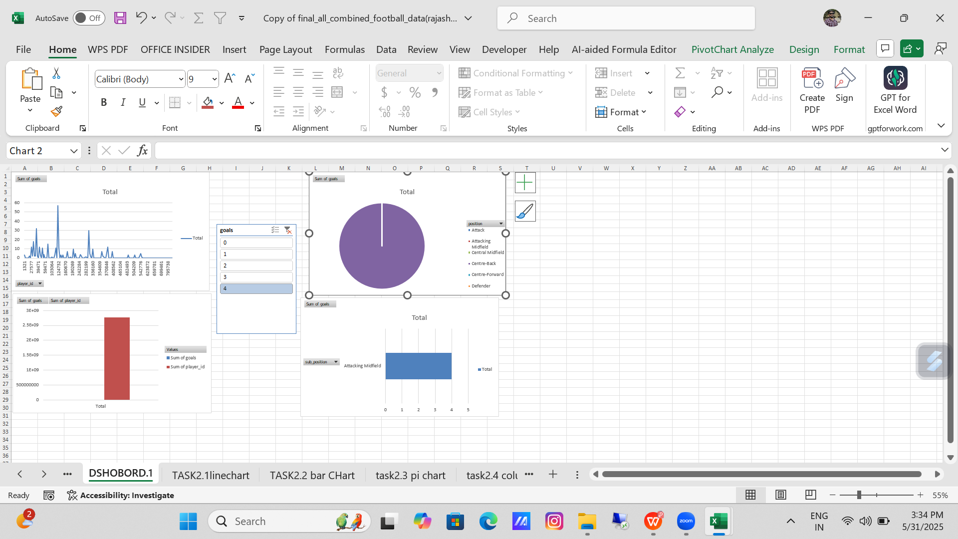
Excel1

Slide 16
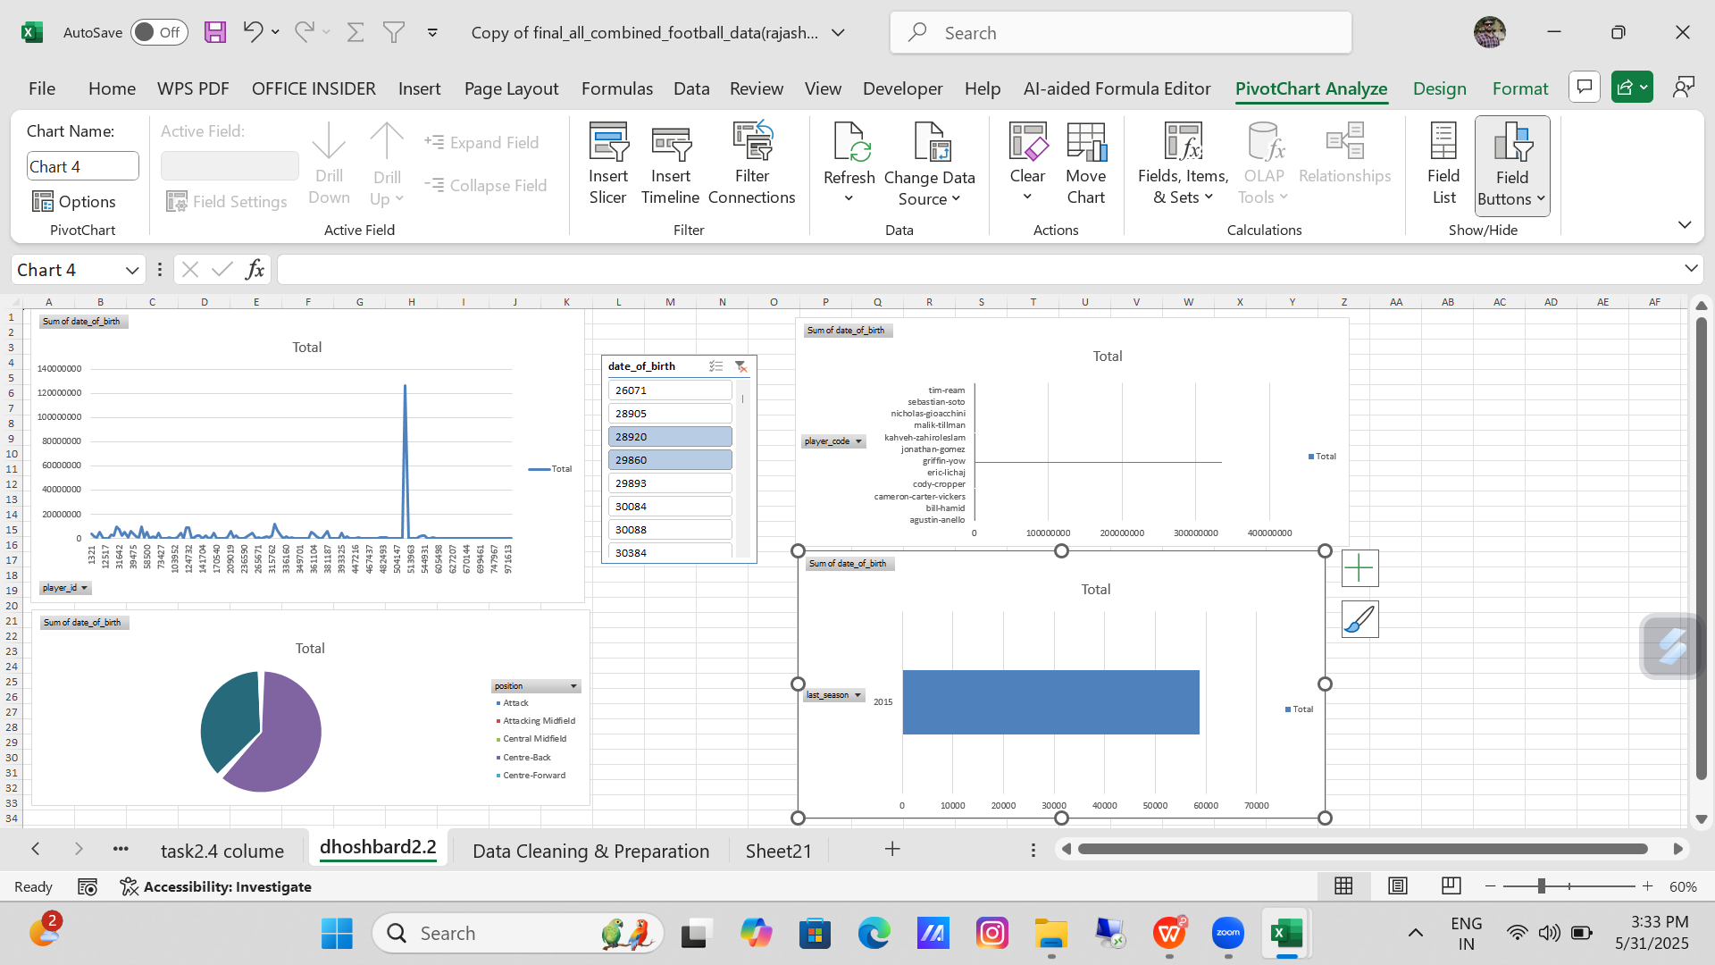
Exce2

Slide 17
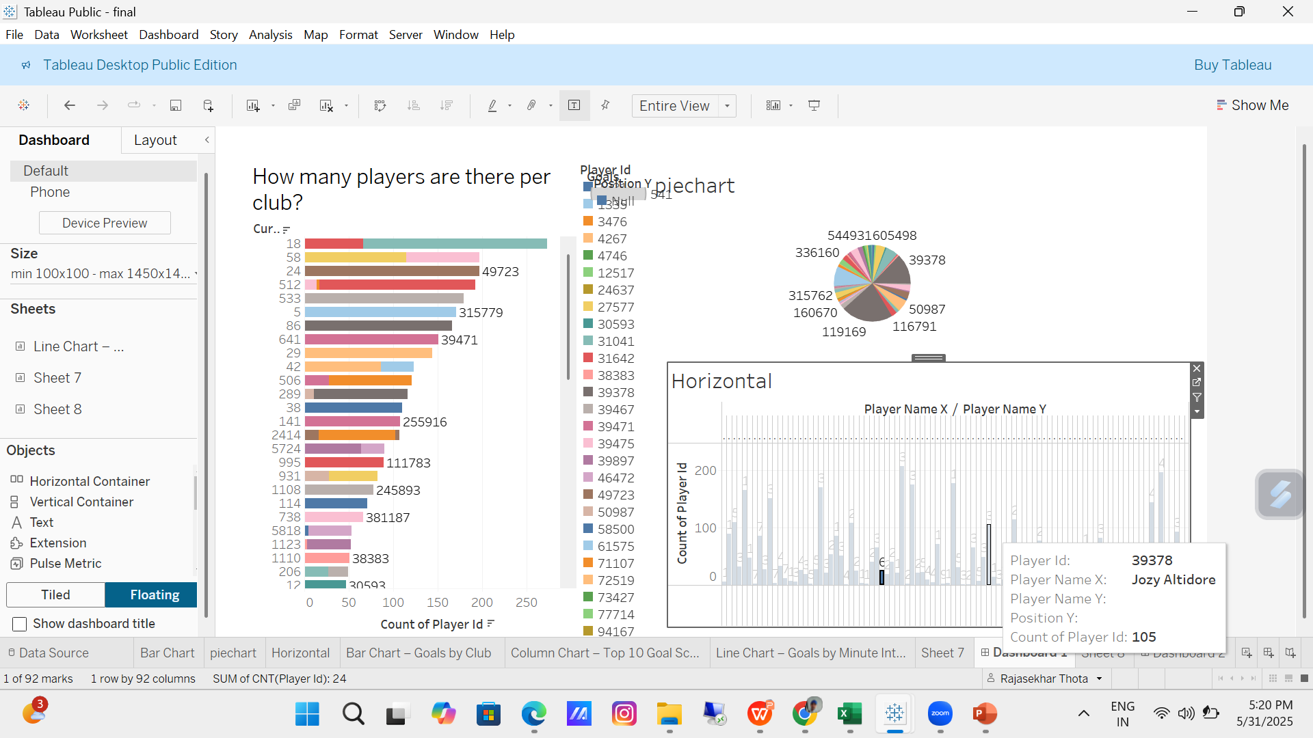
Tableau

Slide 18
table2

Slide 19
Conclusion
The football data analysis project provided a comprehensive view of player performance, team contributions, match dynamics, and market value. Insights from player positions, goals, assists, and minutes played helped identify top performers and efficient players. Team-wise analysis revealed clubs with strong offensive impact, while event analysis showed when goals are most likely to occur. Predictive modeling enabled forecasting of goal potential based on key features. Though stadium attendance data was limited, the project offered valuable business insights for talent management, performance optimization, and data-driven decision-making in football strategy.

Slide 20
Football Data Analysis Capstone Project (summary)
This project involved analyzing football match and player data by merging multiple datasets and cleaning them for consistency. We performed exploratory data analysis to understand event frequencies, player participation, and positional trends. Key insights showed that forwards scored the most goals and playing time had a strong positive impact on goal scoring. Statistical tests confirmed significant differences in performance based on minutes played. Key performance indicators like goals per 90 minutes and card rates helped highlight top-performing players. Feature engineering handled missing data appropriately, and the data was prepared using scaling and encoding techniques for machine learning. The final dataset is now ready for building predictive models to estimate player performance, especially goals.
5/31/2025

Slide 21


THANK YOU
5/31/2025

